Slide 1
ASD device erosion : Do we need to panic ?
Dr.S.Venkatesan MD
Professor of cardiology
Madras medical college
Chennai.India.

Slide 2
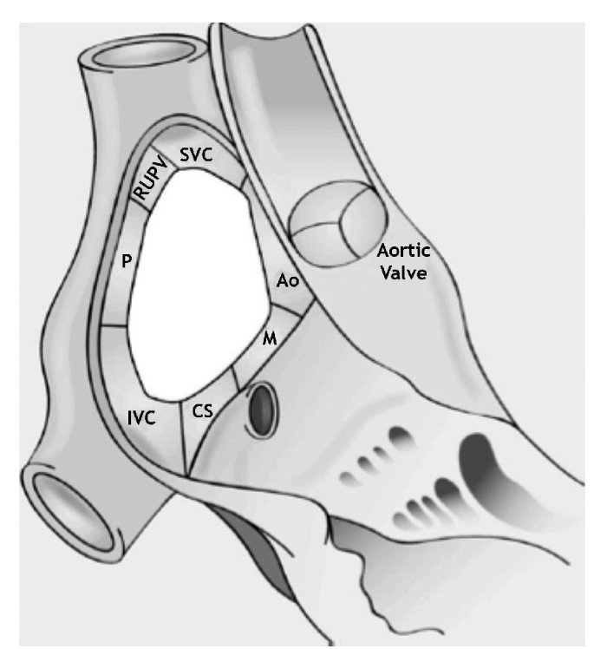

Slide 3
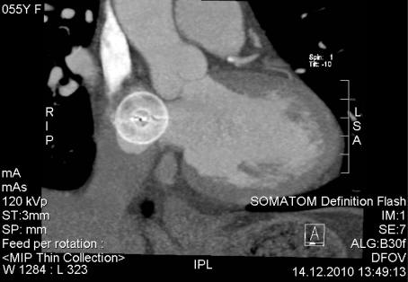

Slide 4
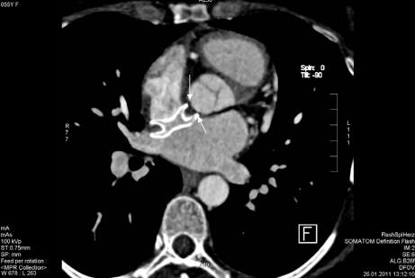

Slide 5
History of Erosions
First erosion case reported in US 2002
2004: IFU updated for device sizing
2009: IFU updated about sizing with additional warning.
2011: SJM/FDA agreed to change IFU to include contra
indications in patients with deficient ant/sup rim

Slide 6
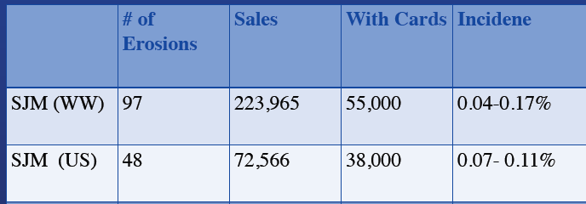
Incidence of Erosion (As of 2012)

Slide 7
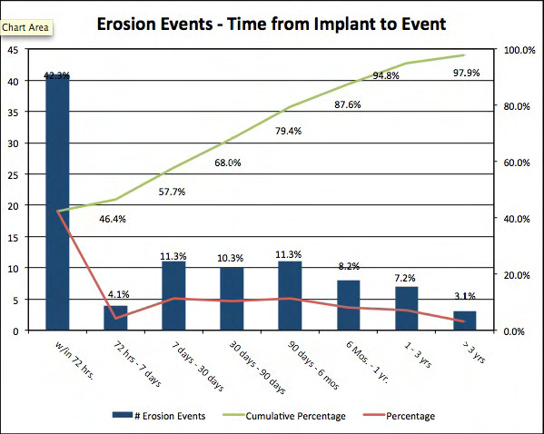
Timing of erosion

Slide 8
Factors associated with erosion
Size of the defect
Deficient rims
Size of the device
Dynamism of ASD
Operator experience
Failure to recognise sub optimal position
Ignoring small pericardial effusion –Filling the transverse sinus

Slide 9
What is a large ASD ? Which is a large device ?
It means different things for different experts .
Peadiatric ASDs > 50 % of IVS (Quereshi)
35 mm ASD ?

Slide 10
The enigma of deficient aortic rims !
30-40 % Aortic rim deficient
5 % other rims

Slide 11
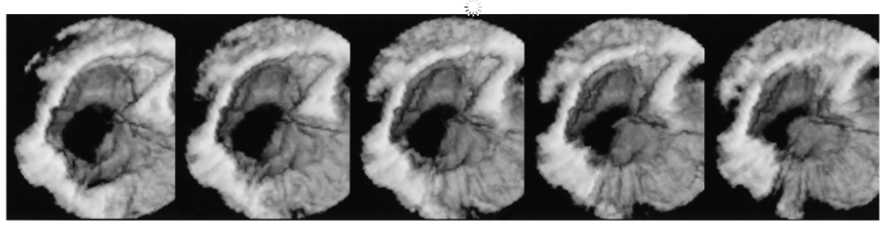
Dynamic nature of ASD orifice
Late diastole
Atrial contraction
End systole

Slide 12
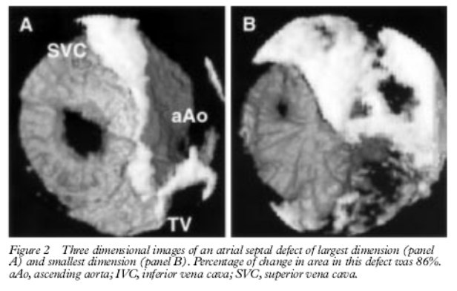
IAS is 86 % dynamic
Maeno Heart , 2000;83 :673–677 41 patients Toroanto Hospital for sick children .
Dynamic morphology of the secundum atrial septal defect evaluated by three
dimensional transoesophageal echocardiography

Slide 13
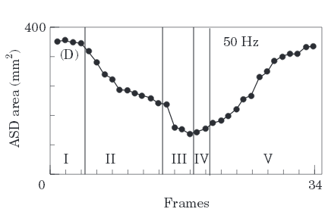
I-isovolumetric ventricular relaxation; II-passive diastolic ventricular
filling; III-atrial contraction; IV-isovolumetric ventricular contraction;
V-ventricular ejection.

Slide 14
Mechanism of dynamism
AV Ventricular plane translational motion
Atrial contraction
Both long and short axis
Less important factors
Heart rate
Age
Size –young more dynamic -

Slide 15
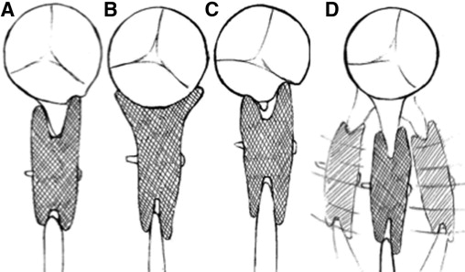

Slide 16
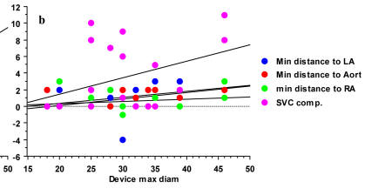
ASD Device interactions with surrounding structures
Philipp Wagdi Zurich, Switzerland
Volume 2, Number 6, December 2011, pages 288-292 Can Computer Tomography Predict Compromise of Cardiac Structures
After Percutaneous Closure of Interatrial Septal Defects?

Slide 17
Impact
Friction
Indentation
Rocking –Antero posterior
Lateral stretch

Slide 18
What are the structures that can erode?
LA – 47 ( 60% Involve Aorta )
RA – 26 ( 50 % involve aorta )
RA & LA – 9
Unknown – 15
Hemodynamic presentation
Tamponade with a hemo PE
Aortic atrial fistula

Slide 19
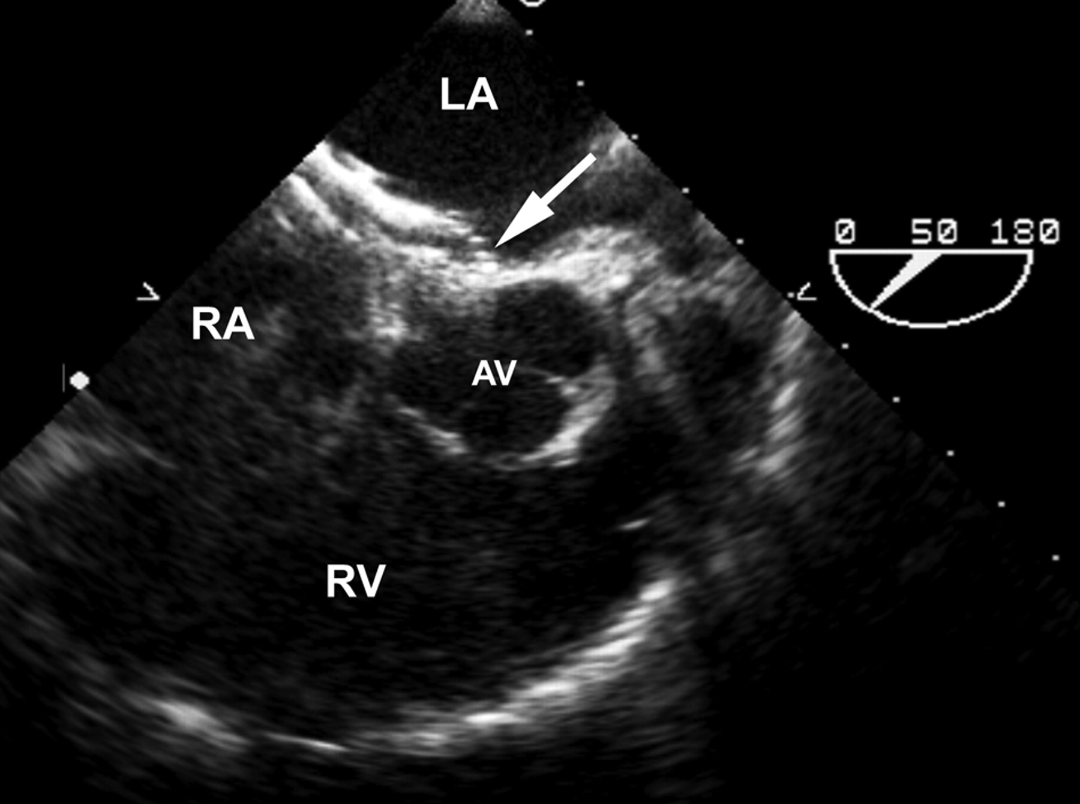
Aortic Intendation

Slide 20
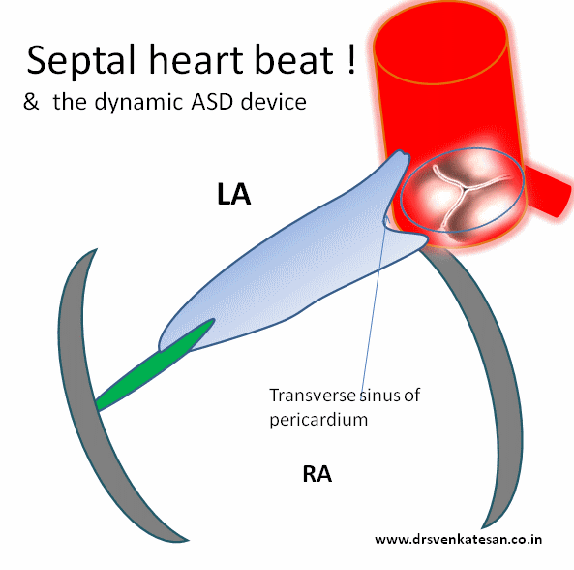

Slide 21
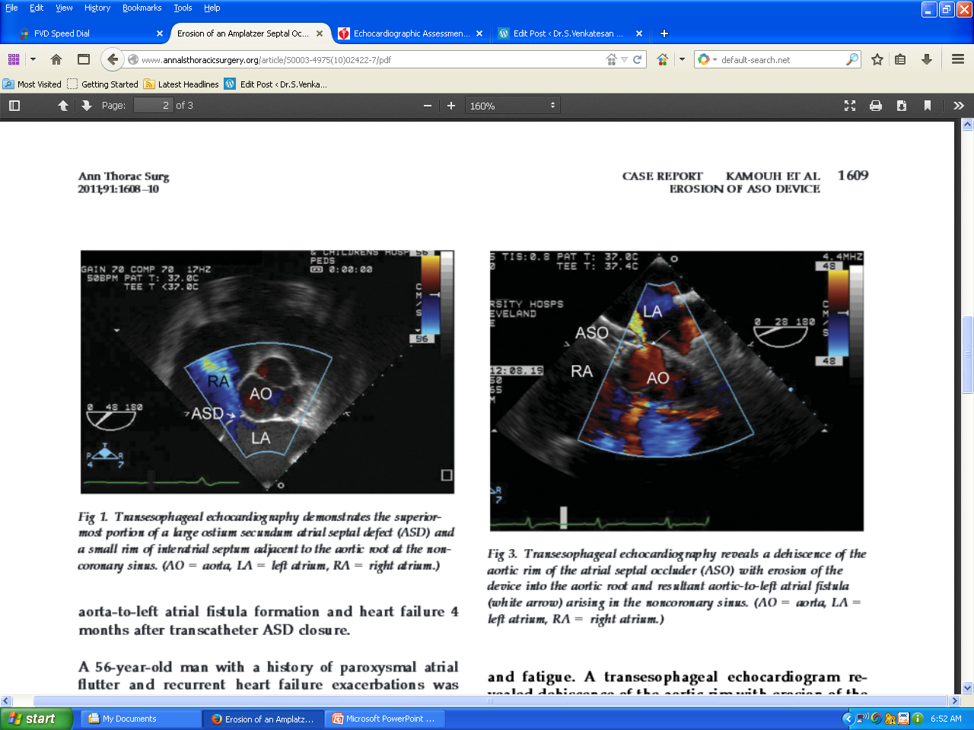
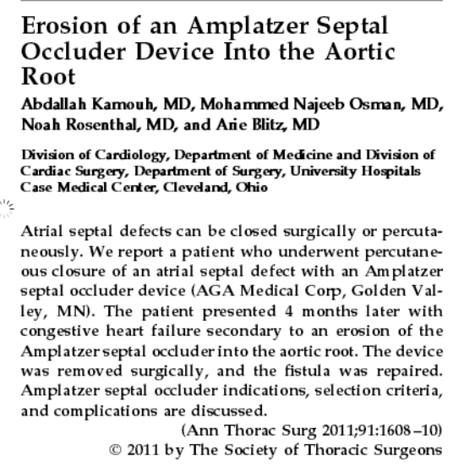

Slide 23
How Erosion is managed ?
SOS to surgeon
Explanted in Most
Other options
Observation follow up
Repair of the erosion site
Pericardiocentesis alone

Slide 24
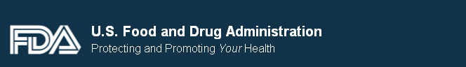
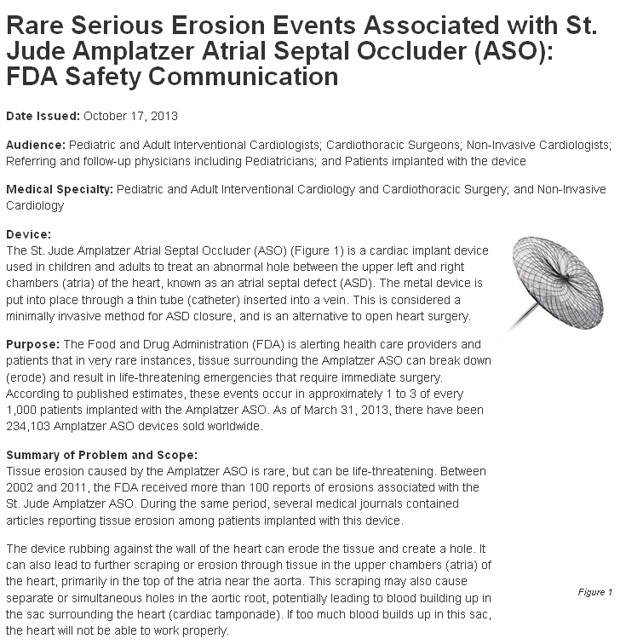
Safety communication –October 2013

Slide 25
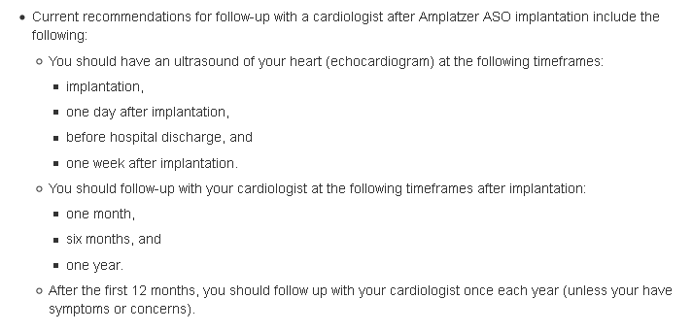

Slide 26
Summary
The erosion is rare
But it is a real Issue
We need not panic
But can not neglect it
Choosing a large device and deficient rims still requires extreme Caution and follow up

